Slide 1

Funny Gorilla诙猩猩-IT培训
Your success is our success
HTTP Introduction

Slide 2
Learning Objectives
By the end of this learning module, you will be able to understand:
What is Transport Protocal
Http introduction
URI
Request Method
Response Code
Data format

Slide 3
grpc

Slide 4
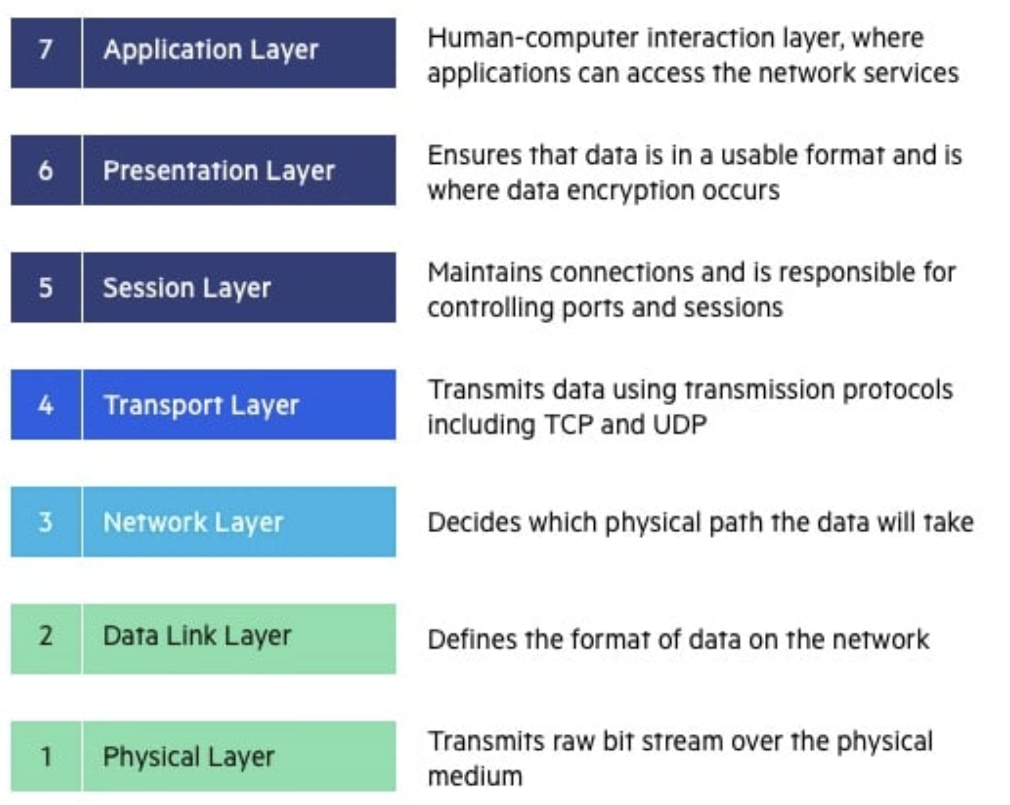
OSI Model

Slide 5
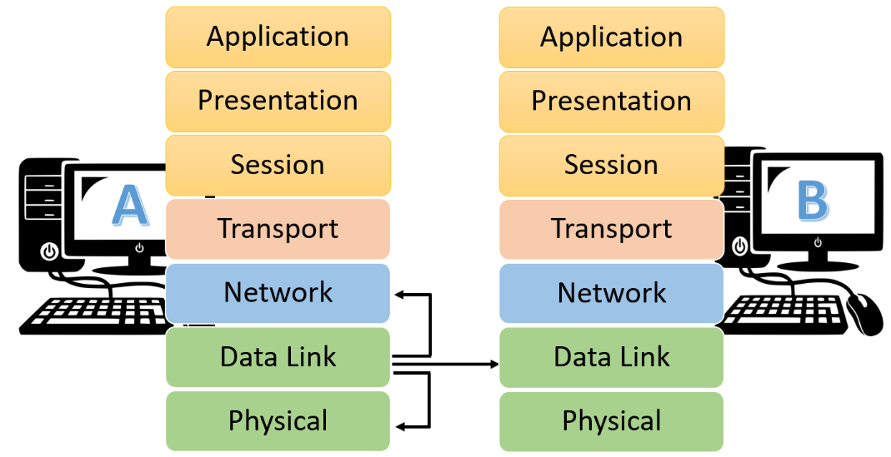

Slide 6
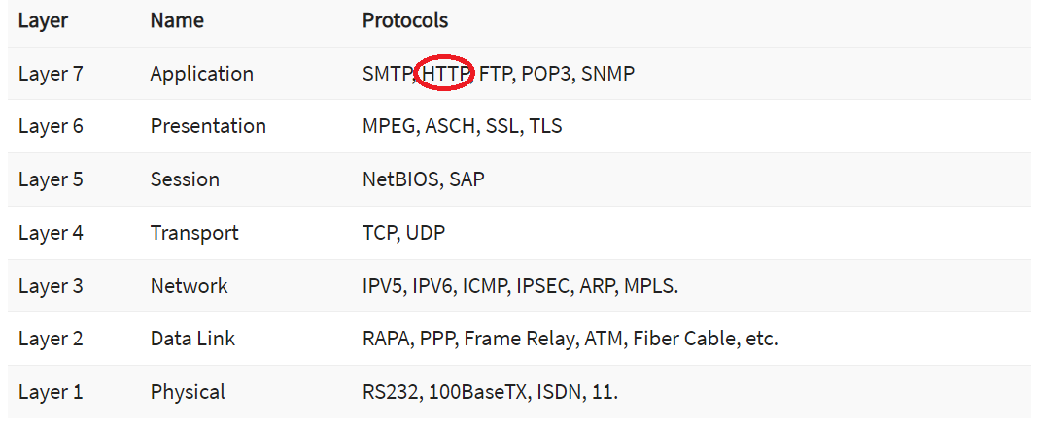
Transport protocol

Slide 7
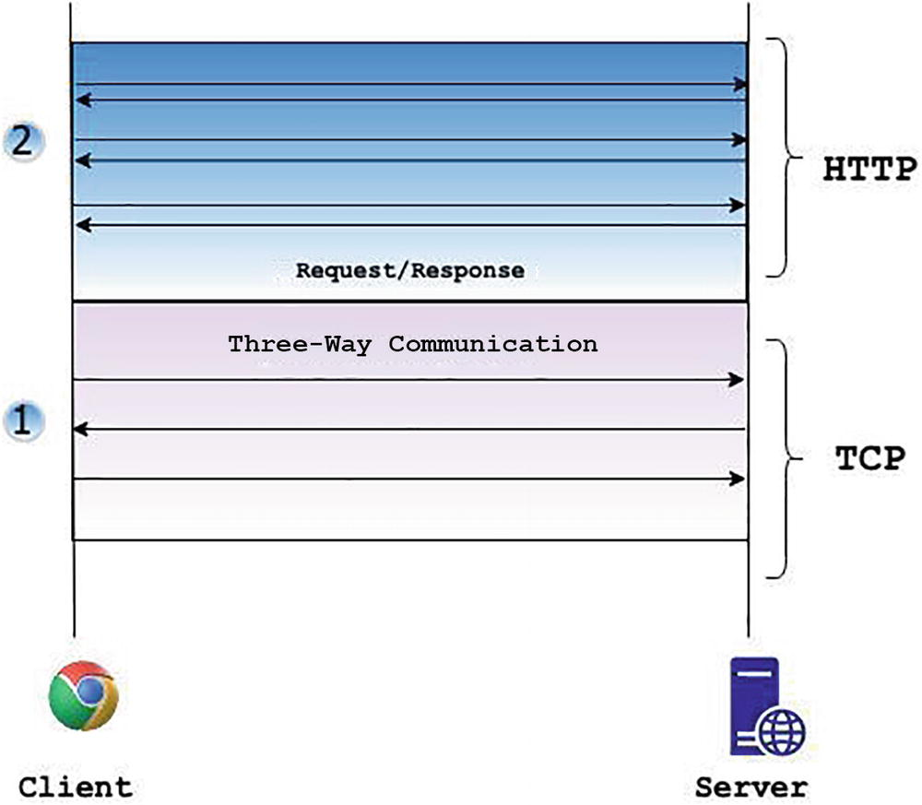
HTTP Introduction
Message
URI
Header
Body
Request / Response
Request Methods
Status Code
Response Message
Synchronous Communication pattern
Request
Message

Slide 8
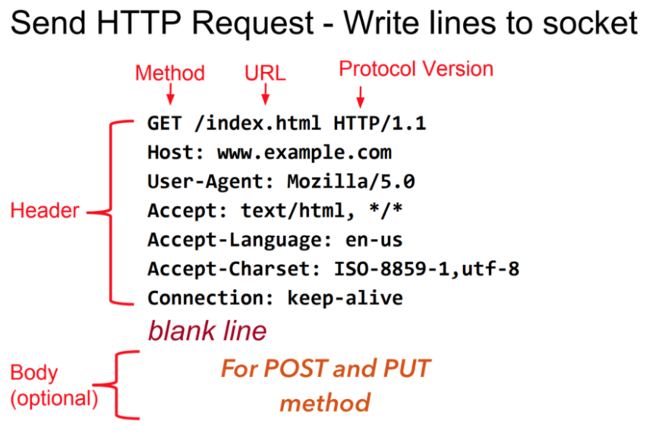
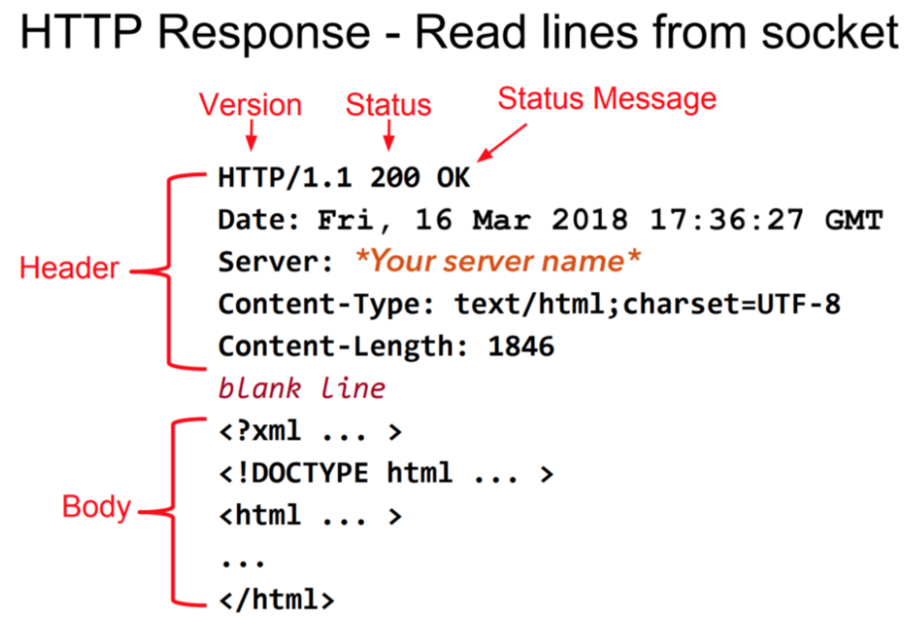
HTTP Sample - header, body, request, response

Slide 9

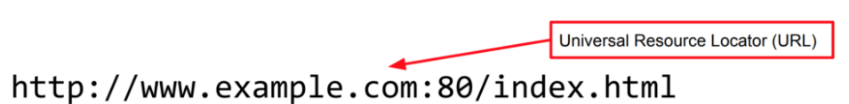
HTTP – URI, URL
www.example.com
168.112.10.10
DNS
Localhost -> 127.0.0.1

Slide 10
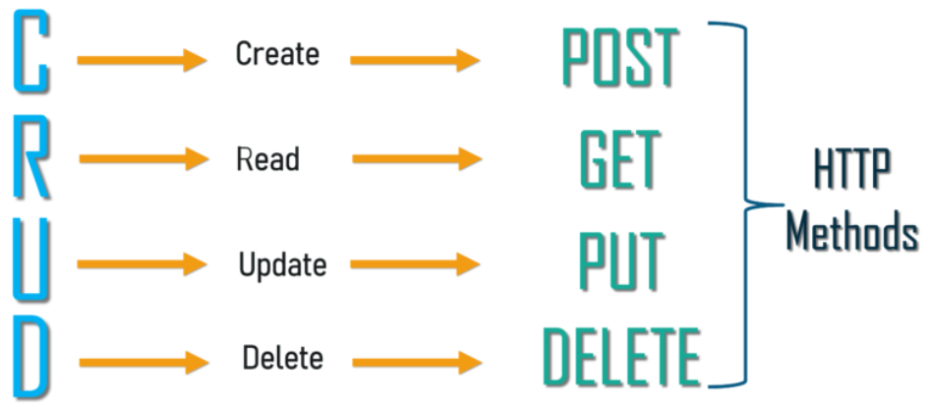
HTTP – Request Methods

Slide 11
HTTP - Status Code
2xx — The request was successful
4xx — The request contains an error of some kind.
  400 Bad Request – This means that client-side input fails validation.
  401 Unauthorized – This means the user isn’t not authorized to access a resource. It usually returns when the user isn’t authenticated.
  403 Forbidden – This means the user is authenticated, but it’s not allowed to access a resource.
  404 Not Found – This indicates that a resource is not found.
5xx — The server encountered an error fulfilling the request.
  500 Internal server error – This is a generic server error. It probably shouldn’t be thrown explicitly.
  503 Service Unavailable – This indicates that something unexpected happened on server side (It can be anything like server overload, some parts of the system failed, etc.).

Slide 12
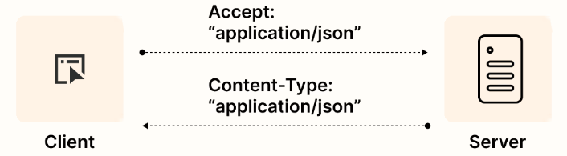
Data format in HTTP

Slide 13
Demo - HTTP

Slide 14
Http Session & Cookies

Slide 15
Http Cookies

Slide 16
Web Storage - HTTP

Slide 17
Event Listener - HTTP

Slide 18
References
Http | https://www.tutorialspoint.com/http/http_overview.htm
XML | https://www.w3schools.com/xml/default.asp
SOAP | https://www.tutorialspoint.com/soapui/soap_introduction.htm
SOAPUI | https://support.smartbear.com/readyapi/docs/get-started.html
JSON | https://www.w3schools.com/js/js_json_intro.asp
REST | https://aws.amazon.com/what-is/restful-api/
Postman | https://learning.postman.com/docs/getting-started/introduction/
https://blog.devgenius.io/how-to-speed-up-your-api-tests-using-the-advanced-features-of-postman-350c453b376

Slide 19

Your success is our success
Contact
Mail: info@funnygorilla.com.au
Linkedin: https://mt.linkedin.com/in/songqing-gu-2ba9034b/de
Web Chat: FunnyGorilla
Phone: 0420891343

